Slide 1









Notes:
What are professional organizations?
What do professional organizations do?
The common thread in all? The more members they have, the more advocacy and the louder the voice..
Of all of these Professional Orgs that are on the screen, which one speaks the most to you, as an Enlisted National Guardsman? That’s right, EANGUS – now lets take a specific look at this Professional Org to see what Professional Orgs do.

Slide 2

EANGUS
FOR the Enlisted
Notes:
Lets look at EANGUS .

Slide 3
Who They Are
Founded in 1972, EANGUS is dedicated to
promoting the interests and professionalism
of enlisted personnel of the National Guard.
An Association of Associations – 55 Chapters: 54 States and Territories plus one national chapter. Each State Chapter is its own 501c non-profit with its own Bylaws
EANGUS is the only military service organization that exists solely to represent the enlisted men and women of the National Guard, veterans, retirees and their families on Capitol Hill, the Pentagon and other governmental organizations.
Notes:
SLIDE 2: Professionals belong to professional organizations and EANGUS is YOUR professional association. EANGUS has been around for over 50 years, and recently celebrated our 50th Anniversary Conference in August 2021.
It was created in 1970 by group of Senior NCOs from South Dakota and Mississippi who had the strategic vision to organize and expand their local efforts across the entire United States. They saw a need to have a larger overall effect and to advocate for ENLISTED National Guard members at the national level. EANGUS was formally organized in 1972 and incorporated in Jackson, Mississippi in April 1974. The first national EANGUS Conference was held in Sioux Falls, South Dakota in September 1972. At that time, EANGUS had chapters in 23 states.
Since those early days, EANGUS has grown and currently has chapters in every State, Territory, the District of Columbia and there is a chapter that represents enlisted members serving on Title 10 tours. Each State is its own organization, with its own bylaws and non-profit status, but they have also been chartered and approved by EANGUS which is considered the “parent” or national organization.
While there are many professional associations out there that you can belong to, many of them have divided loyalties. Organizations such as the Association of the United States Army (AUSA), the Air Force Association (AFA), or the Reserve Association of America (ROA), all represent Active Duty personnel and/or members of other Reserve Components – they represent more than just our National Guard members,… and they represent members of all ranks. EANGUS is the only military service organization whose sole purpose is to represent enlisted members of the National Guard, our Veterans, and our families.

Slide 4
What They Do
Vision: To be the premier professional Association bettering the lives of enlisted National Guard members, veterans, and their families.
Mission: Promote, safeguard and improve the status, welfare, and professionalism of enlisted National Guard members, veterans, retirees, and their families through legislation, employment, education, emergency resources and partnerships.
Notes:
SLIDE 3: This is the EANGUS Vision and Mission. The mission statement was recently updated as part of the EANGUS Strategic Plan to reflect not just our advocacy and legislative efforts, but also our overall strategic goals and objectives which includes providing employment, education, and emergency resources for National Guard members, as well as continuing to build partnerships and relationships which will benefit our members and the association as a whole.

Slide 5
Why They Exist
The Anti-lobbying Act (18 USC 1913) prohibits expenditure of Federal funds on grassroots lobbying efforts to include public contact with Congress concerning legislation or appropriations. Fiscal Law dictates the same.
As an advocacy organization, EANGUS is able to discuss issues that affect the National Guard and are not obligated to support the President’s Budget Proposal or Administration priorities like NGB must.
State Associations also represent their members and initiate or support legislation to provide additional “State Benefits”.
Notes:
SLIDE 4: Why do Professional Military Organization like EANGUS exist? NGB staff and those on Title 10 / active duty cannot lobby Congress per the Anti-Lobbying Act. EANGUS constantly communicates with the Legislative Liaison Staff at NGB, National Guard leadership, as well as the ARNG’s Command Sergeants Major Advisory Council (CSMAC) and the ANG’s Enlisted Field Advisory Council (EFAC), and others regarding resources and issues that are important to the National Guard. As an advocacy organization, EANGUS is able to discuss issues that affect the National Guard and are not obligated to support the President’s Budget Proposal or Administration priorities like NGB must.
When we go to Congress, EANGUS speaks on behalf of our 36,000 plus paid members, but we also represent the entire National Guard community which includes over 450,000 members of the National Guard, as well as over 300,000 National Guard retirees, and all their family members. EANGUS advocates on our behalf, not only seeking to improve or increase benefits and resources, but there are times when we have to fight to keep what we have and ensure there is no erosion or elimination of the benefits we have earned based on our service. In a lot of cases, our advocacy efforts and the legislation we work to initiate and support, impacts not only our National Guard members, but oftentimes, a piece of legislation my impact members of other reserve components and other Veterans, as well. Bottom line, without EANGUS and other Veteran and Military Service Organizations doing this type of work, we would not have the benefits we currently enjoy.
Additionally, State Associations also initiate legislation or support legislation impacting National Guard members locally. Many of our State Associations have been successful in obtaining “State Benefits” such as State tax exemptions on military retired pay, additional State-provided education tuition waivers for members of the National Guard, free entry into State parks, etc. (Speaker may expand on State Benefits you have.)

Slide 6
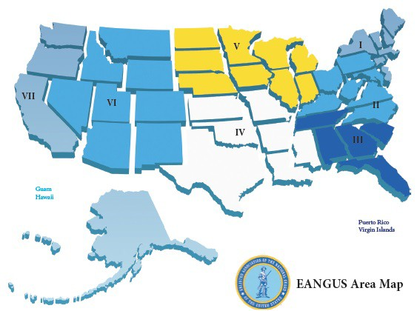


Where We Are
EANGUS National Office
1 Massachusetts Avenue NW, Suite 880, Washington DC 20001
Notes:
SLIDE 5: As mentioned earlier, EANGUS has chapters in every State across the entire United States, and those State Associations are grouped together into seven Areas as shown in this graphic. Each Area elects three personnel who serve as liaisons between the State Associations and the EANGUS, the national organization. Those 21 members from across the U.S. serve on the EANGUS Executive Council and make up our national board of directors along with an elected President, Vice-President, Secretary and Treasurer. All of those board members are non-paid volunteers who represent the members from their Areas year-round.
Additionally, EANGUS currently has five full-time paid staff who work at the National Office located closed to Capitol Hill. These staff manage/supervise the National Office, lead our lobbying efforts on Capitol Hill, manage our membership programs and services, conduct marketing and business development, and manage our emergency financial assistance programs. This location provides many opportunities to work closely with Congressional members and staffers. It also allows EANGUS to work closely with our sister association, NGAUS, who owns the National Guard Memorial Building and occupies the bottom two floors, while EANGUS has an office on the 8th floor.
EANGUS also has an Auxiliary with chapters across the U.S. The Auxiliary is made up of spouses and family members of our EANGUS members. Many of these Auxiliary members are also very active in National Guard family programs events within each of their States, and they play a big part in our EANGUS grassroots advocacy efforts as we work to pass legislation to benefit the National Guard community.

Slide 7
EANGUS Legislative Priorities
Reserve Component medical readiness & TRICARE expansion
Align TRICARE coverage with early retirement
Tax incentives for employers to hire members of the Guard
Equity of benefits for Guard/Reserve under Duty Status Reform
Retiree continued contributions to the Thrift Savings Plan
Improved access to mental health care and treatment
Equal Hazardous Duty Incentive Pay for NG/RC members
NG/Res Retiree Transition Assistance Program
Fully funded training for required schools
Funding for NG Cyber missions, teams, and training
Civilian licenses and certification for military training
Funding for NG Counterdrug Program
Support for the Space National Guard
Childcare during UTA Weekends
Notes:
SLIDE 6: Speaking of our legislative focus, this shows some of the current EANGUS Legislative Priorities (these are for the 2nd Session of the 117th Congress, 2022). EANGUS develops priorities each year based on the Resolutions submitted by our members. Each year, members like you, identify and document an inequity in law or policy or some other problem, and suggest a change by writing a Resolution. Members may also identify the need for additional funding, equipment, or resources, as you can see by some of the items on this list. These individual Resolutions are reviewed at the State and Area level and are ultimately reviewed and voted on by the delegates who attend the annual EANGUS National Conference. Once the Resolutions are approved, the EANGUS Legislative Staff develops a priority list like this which drives their work and activities during the current session of Congress.
Throughout the year, as legislation is introduced in the House or Senate, EANGUS members will receive a “Call to Action” message from the EANGUS Legislative Team, asking them to contact their elected officials in Washington, DC.. This is the way you can express your opinion about an issue and solicit Congressional support for one of these priorities. In the “Call to Action”, EANGUS members, Auxiliary members, or any National Guard member, family, friend, co-worker, or supporter is asked to write to Congress. A prepared email letter is provided, making it very quick and easy to send that email. If you receive or see one of these Calls to Action, we ask you to respond. This is the best way to lend your voice and let the officials you elected know what matters most to you and what resources you need as a member of the National Guard.
NOTE: Before briefing, if Speaker has time and wants to go into more detail, please check the EANGUS Website’s Legislative Action Center for details and updates on any of these priorities or check with the National Office Executive Director, Matt Krenz (matt@eangus.org) or Legislative Director, Kevin Hollinger (kevin@eangus.org) for details.

Slide 8
Membership Benefits
Scholarships: EANGUS awards over $300,000 annually in full-ride and partial scholarships from various University partners, corporate partner sponsorships, and personal donations.
Professional Development : EANGUS provides opportunities for professional development several times each year in order to assist our members in understanding how government works and the role EANGUS plays in the legislative process. Additionally, these events give National Guard servicemembers the opportunity to hear current information from Senior Military and government leaders.
News & Publications: EANGUS membership includes a subscription to the quarterly New Patriot Magazine, the monthly Drill Weekend Talking Points, and a weekly Minuteman Update as well as other information.
Notes:
SLIDE 7: In addition to advocating for the National Guard on Capitol Hill, EANGUS provides a number of member benefits which are highlighted on the next couple of slides.
One of the largest benefits offered is the Scholarship program. Each year, over $300,000 in scholarships is awarded to current EANGUS members and their dependents. This includes FULL-RIDE scholarships to institutions such as University of Phoenix, Grand Canyon University, Grantham and Colorado Tech, as well as $1000 and $2000 cash scholarships. In addition to what EANGUS offers, most State Associations also offer a number of State-level cash scholarships that members can apply for. If you, or your spouse or child, are pursuing a college education, this is a great opportunity.
EANGUS also offers a number of Professional Development and networking opportunities throughout the year. One of them is the Professional Development program at the National Conference. This is a nationally recognized PD program and the Chief, NGB authorizes a certain number of junior enlisted National Guard members (E6 and below), per State, to attend the EANGUS Conference on paid military orders. EANGUS brings many high level guest speakers to the conference providing opportunities for attendees to speak directly with DOD, NGB, VA, and other leaders.
EANGUS also provides a number of publications to our members to keep them informed. This includes the quarterly New Patriot Magazine which is mailed to your home and/or sent electronically, the monthly Drill Weekend Talking Points message providing the latest topics to share with other unit members, and a weekly e-newsletter called the Minuteman Update.

Slide 9
Membership Benefits (continued)
Insurance: As a member of EANGUS, you have access to a variety of plans and discounts. Learn more about quality insurance coverage at group rates: Accidental Death & Dismemberment Insurance, Term Life Insurance, and Technician Insurance.
Programs: Employment Resources, Partner Organization Discounts, Fitness Challenge, and Travel Opportunities and discounts. EANGUS members also receive a complimentary membership in the Association of the United States Army (AUSA).
Financial Assistance: With thousands of National Guard members and their families facing financial hard-ships as a result of the ongoing COVID-19 pandemic and other catastrophic events, the EANGUS We Care For America National Guard Emergency Relief Fund is available to help those in need.
Notes:
SLIDE 8: EANGUS also offers a number of group insurance options. One of them is the Accidental Death & Dismemberment policy which is provided to all active EANGUS members. This $2500 Accidental Death & Dismemberment insurance policy, is provided at no extra cost to each EANGUS member. You can get more information on insurance programs on the EANGUS website, under the Membership / Benefits tab.
EANGUS offers a number of other programs to our members. Your membership in EANGUS also gives you a complimentary membership in AUSA; so, you are getting membership in TWO professional associations for the price of ONE! This AUSA membership benefit is for both Army and Air National Guard members and is automatic unless you opt out. This program enables EANGUS members to take advantage of all the member Discounts and benefits that AUSA offers to their members. EANGUS also offers discounts provided by our partners like Dell, T-Mobile, etc. Additionally, if you’re into Fitness, there is the EANGUS Fitness Challenge Committee which offers several fitness events each year, motivating their members and giving prizes for challenge winners. They will be hosting a 5K Walk/Run at the National Conference this year. In addition to current programs, EANGUS is also working to improve and add more employment and educational opportunities for our members.
Finally, there is help available for National Guard members who are facing financial hardships due to COVID or other catastrophic events. Let’s go to the next slide for some more detailed information about the We Care for America National Guard Emergency Relief Fund.

Slide 10

Help for NG Soldiers and Airmen
The We Care for America Foundation, Inc. (WCFA) is the 501c(3) charitable arm of EANGUS. The WCFA National Guard Emergency Relief Fund currently provides THREE types of emergency assistance:
  Individual SARGE grants (usually $500)
  Disaster relief (for major declared emergencies)
    No-interest loans up to $2,000
  Since 2004, WCFA has provided almost $2M to NG members, which includes almost $1M in grants given to NG members impacted by the COVID 19 pandemic over the last two years. These grants and the establishment of our No-Interest Loan program were made possible by significant donations from USAA and the USAA Foundation.
  For more info on the WCFA, to apply for assistance, or donate, go to https://eangus-wcfa.org
Notes:
SLIDE 9: Here’s some additional details about the Financial Assistance program that EANGUS operates, mentioned on the last slide. The We Care For America Foundation is the 501c(3) charitable arm of EANGUS which provides emergency financial assistance to National Guard members. Membership in EANGUS is not required to apply, and these funds are open to both enlisted and officers who have a valid emergency. As you can see, both Grants and No-interest loans are available. Grants are usually $500; however, if you’re an EANGUS member, you may qualify for more funds depending on the circumstances. No-interest loans can be approved for up to $2,000 with repayment of those loans in small increments over time.
The NO-INTEREST LOAN program was opened in February 2021 and was made possible by several significant donations from USAA. USAA also provided the funding which allowed We Care for America to distribute almost $1M in grants to National Guard members impacted by the COVID pandemic since May 2020. If you’ve heard of Army Emergency Relief or the Air Force Aid Society, this program is similar to those; however, as you know, AER and AFA are generally not available to Traditional Guardsmen. The EANGUS National Guard Emergency Relief Fund is available to all National Guard Soldiers and Airmen, regardless of military status or rank, and can provide assistance to currently serving, former or retired National Guard members.
Since 2004, WCFA has assisted well over 3,000 NG families; and provided almost $2M in grant funds to those in need. This is an outstanding resource for National Guard members needing help. If you hear of National Guard members who need assistance, please refer them to the website shown on this slide.
During CFC Season: WCFA is also part of the Combined Federal Campaign; we ask everyone in the National Guard to support that fund. Our CFC Number is 11859

Slide 11

Major Events
The EANGUS National Conference is held each August and is attended by approx. 1,200 enlisted members from across the U.S. The National Conference includes Senior Level DOD and NGB Guest Speakers, Professional Development, Committee Meetings, an Awards Banquet, and other activities.
The EANGUS Legislative Workshop
and ‘Muster for Change’ Hill Event
brings approximately 125 members
to Washington DC each year in late
February/early March.
Notes:
SLIDE 10: I’ve just touched the surface regarding who, what, where and why EANGUS is important and why you should be a member of this professional association. Another great opportunity to learn first-hand about EANGUS and participate in their activities is by attending one of the major EANGUS events.
As I mentioned at the beginning, the first EANGUS Conference was held in Sioux Falls, SD in 1972 ---- the 51st Annual Conference will be held in Little Rock, AR from 7-10 August 2022. Registration is already open and details will be provided throughout the year on the EANGUS website and their social media sites. Attended annually by over 1,2,00 Soldiers and Airmen from across the U.S. this is a great networking and learning environment.
The second major EANGUS event is the annual Legislative Workshop and Congressional Reception, held in Washington, DC in the Feb/March timeframe. During this event, EANGUS members receive updates on current legislative activities and hear from guest speakers such as Congressional Members or Staffers, NGB leaders and legislative staff, and others. EANGUS members from the State Association also “muster for change’ and make visits to the offices of their congressional representatives in DC during this time, sharing those issues and legislative priorities that are important to the enlisted force.
(Speaker can mention their own experiences at conference, opportunities to attend on professional development orders, etc.)

Slide 12

CAL-EANGUS
Professionals Belong to Professional Organizations
Notes:
As each state is a chapter, lets next look at the California chapter of EANGUS called CAL EANGUS

Slide 13
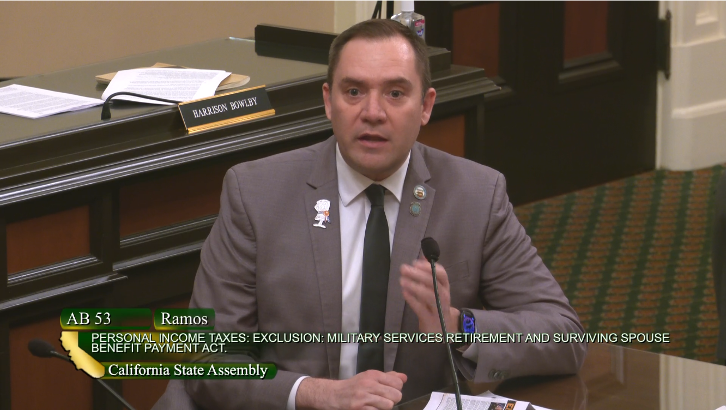
Major State Legislative Wins
CalGuard Educational Assistance Fund Award Program (EAAP)
Discounted Hunting/Fishing Licenses for disabled Veterans
California CDL Testing Waiver
Passed law allowing State Employees to use military leave to attend Drill (IDT).
Reviews State legislation directly
impacting National Guardsmen
$20K tax-free military pensions
Notes:
SLIDE 12: CAL-EANGUS sponsored the piece of legislation that wrote into law the CAL GUARD Educational Assistance Fund Award Program – This program is available for all Cal Guardsmen and is an additional source of funding while attending college.
CAL-EANGUS Supported legislation that reduced the cost of hunting and fishing licenses for disabled veterans.
CAL-EANGUS sponsored a bill that allows any military operator who is certified on heavy equipment (i.e.: 88M) and take their records to the DMV and receive their Commercial Driver’s License.
In 2021, CAL-EANGUS Sponsored legislation to assist the California Military Department Support Fund. The Support Fund is funded by donations and designed to provide financial support to California Guardsmen and their Families who are in financial distress. CAL-EANGUS’ bill changed the California fiduciary law making it easier and quicker for the Support Fund to issue grant checks to Servicemembers; wait time declined from 30+ days once the grant was approved to less than 5 days.
CAL-EANGUS is a member of a legislative review committee; all bills that impact National Guardsmen and Veterans are reviewed by the board and the board provides recommendations and support on legislation.
A current bill that we (and the rest of the committee) is pushing is a bill that will stop taxing military pensions. California is the only state in the nation that fully taxes military pension and CAL EANGUS has been working with California Legislators on getting this bill signed into law.
(Speaker can mention their own experiences at conference, opportunities to attend on professional development orders, etc.)

Slide 14
EANGUS Legislative Priorities
Reserve Component medical readiness & TRICARE expansion
Align TRICARE coverage with early retirement
Tax incentives for employers to hire members of the Guard
Equity of benefits for Guard/Reserve under Duty Status Reform
Retiree continued contributions to the Thrift Savings Plan
Improved access to mental health care and treatment
Equal Hazardous Duty Incentive Pay for NG/RC members
NG/Res Retiree Transition Assistance Program
Fully funded training for required schools
Funding for NG Cyber missions, teams, and training
Civilian licenses and certification for military training
Funding for NG Counterdrug Program
Support for the Space National Guard
Childcare during UTA Weekend
Notes:
SLIDE 6: Speaking of our legislative focus, this shows some of the current EANGUS Legislative Priorities (these are for the 2nd Session of the 117th Congress, 2022). EANGUS develops priorities each year based on the Resolutions submitted by our members. Each year, members like you, identify and document an inequity in law or policy or some other problem, and suggest a change by writing a Resolution. Members may also identify the need for additional funding, equipment, or resources, as you can see by some of the items on this list. These individual Resolutions are reviewed at the State and Area level and are ultimately reviewed and voted on by the delegates who attend the annual EANGUS National Conference. Once the Resolutions are approved, the EANGUS Legislative Staff develops a priority list like this which drives their work and activities during the current session of Congress.
Throughout the year, as legislation is introduced in the House or Senate, EANGUS members will receive a “Call to Action” message from the EANGUS Legislative Team, asking them to contact their elected officials in Washington, DC.. This is the way you can express your opinion about an issue and solicit Congressional support for one of these priorities. In the “Call to Action”, EANGUS members, Auxiliary members, or any National Guard member, family, friend, co-worker, or supporter is asked to write to Congress. A prepared email letter is provided, making it very quick and easy to send that email. If you receive or see one of these Calls to Action, we ask you to respond. This is the best way to lend your voice and let the officials you elected know what matters most to you and what resources you need as a member of the National Guard.
NOTE: Before briefing, if Speaker has time and wants to go into more detail, please check the EANGUS Website’s Legislative Action Center for details and updates on any of these priorities or check with the National Office Executive Director, or Legislative Director, Kevin Hollinger (kevin@eangus.org) for details.

Slide 15
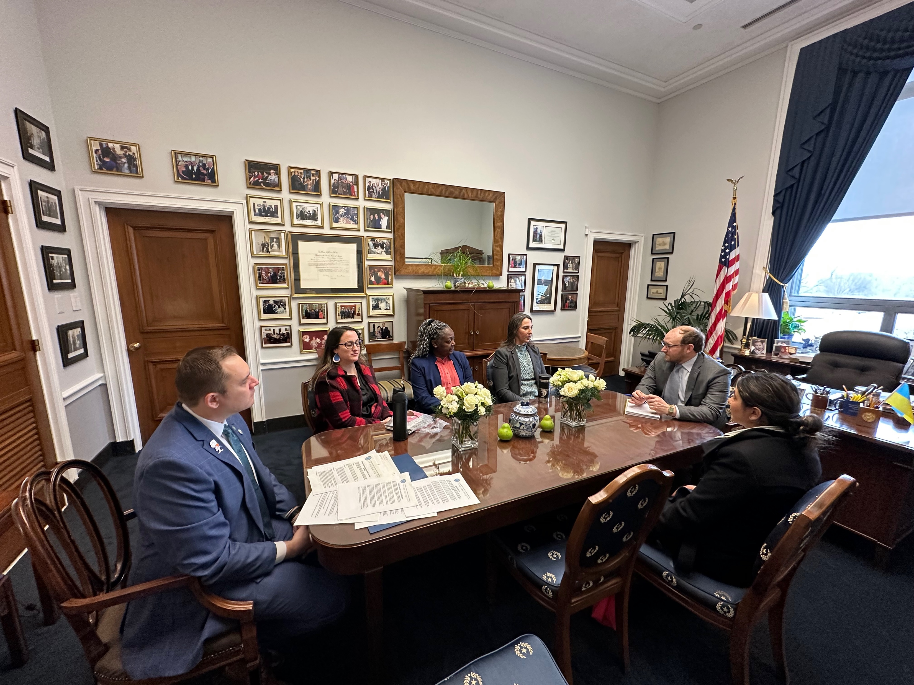
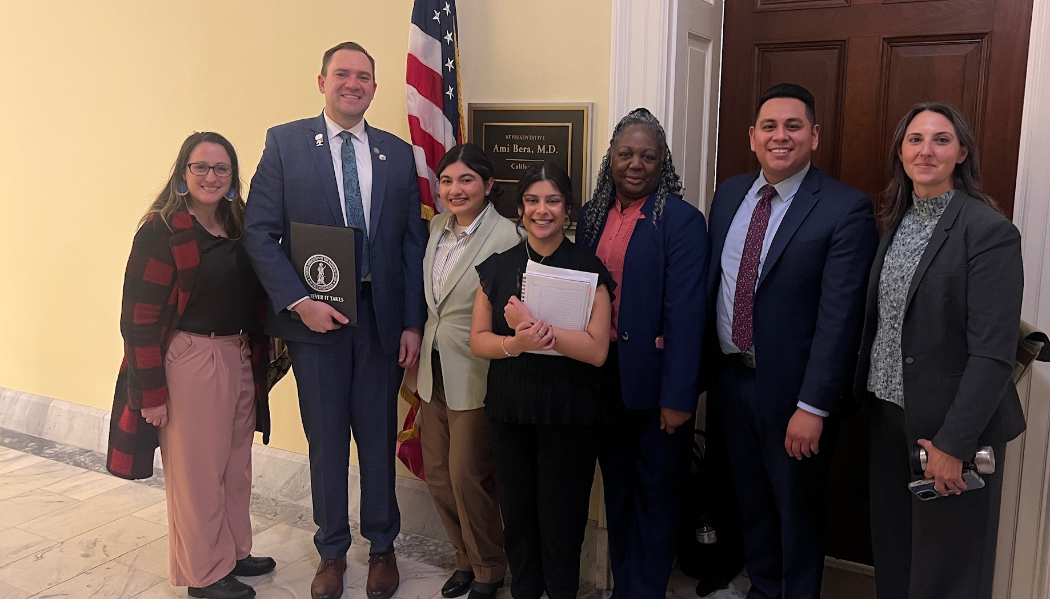
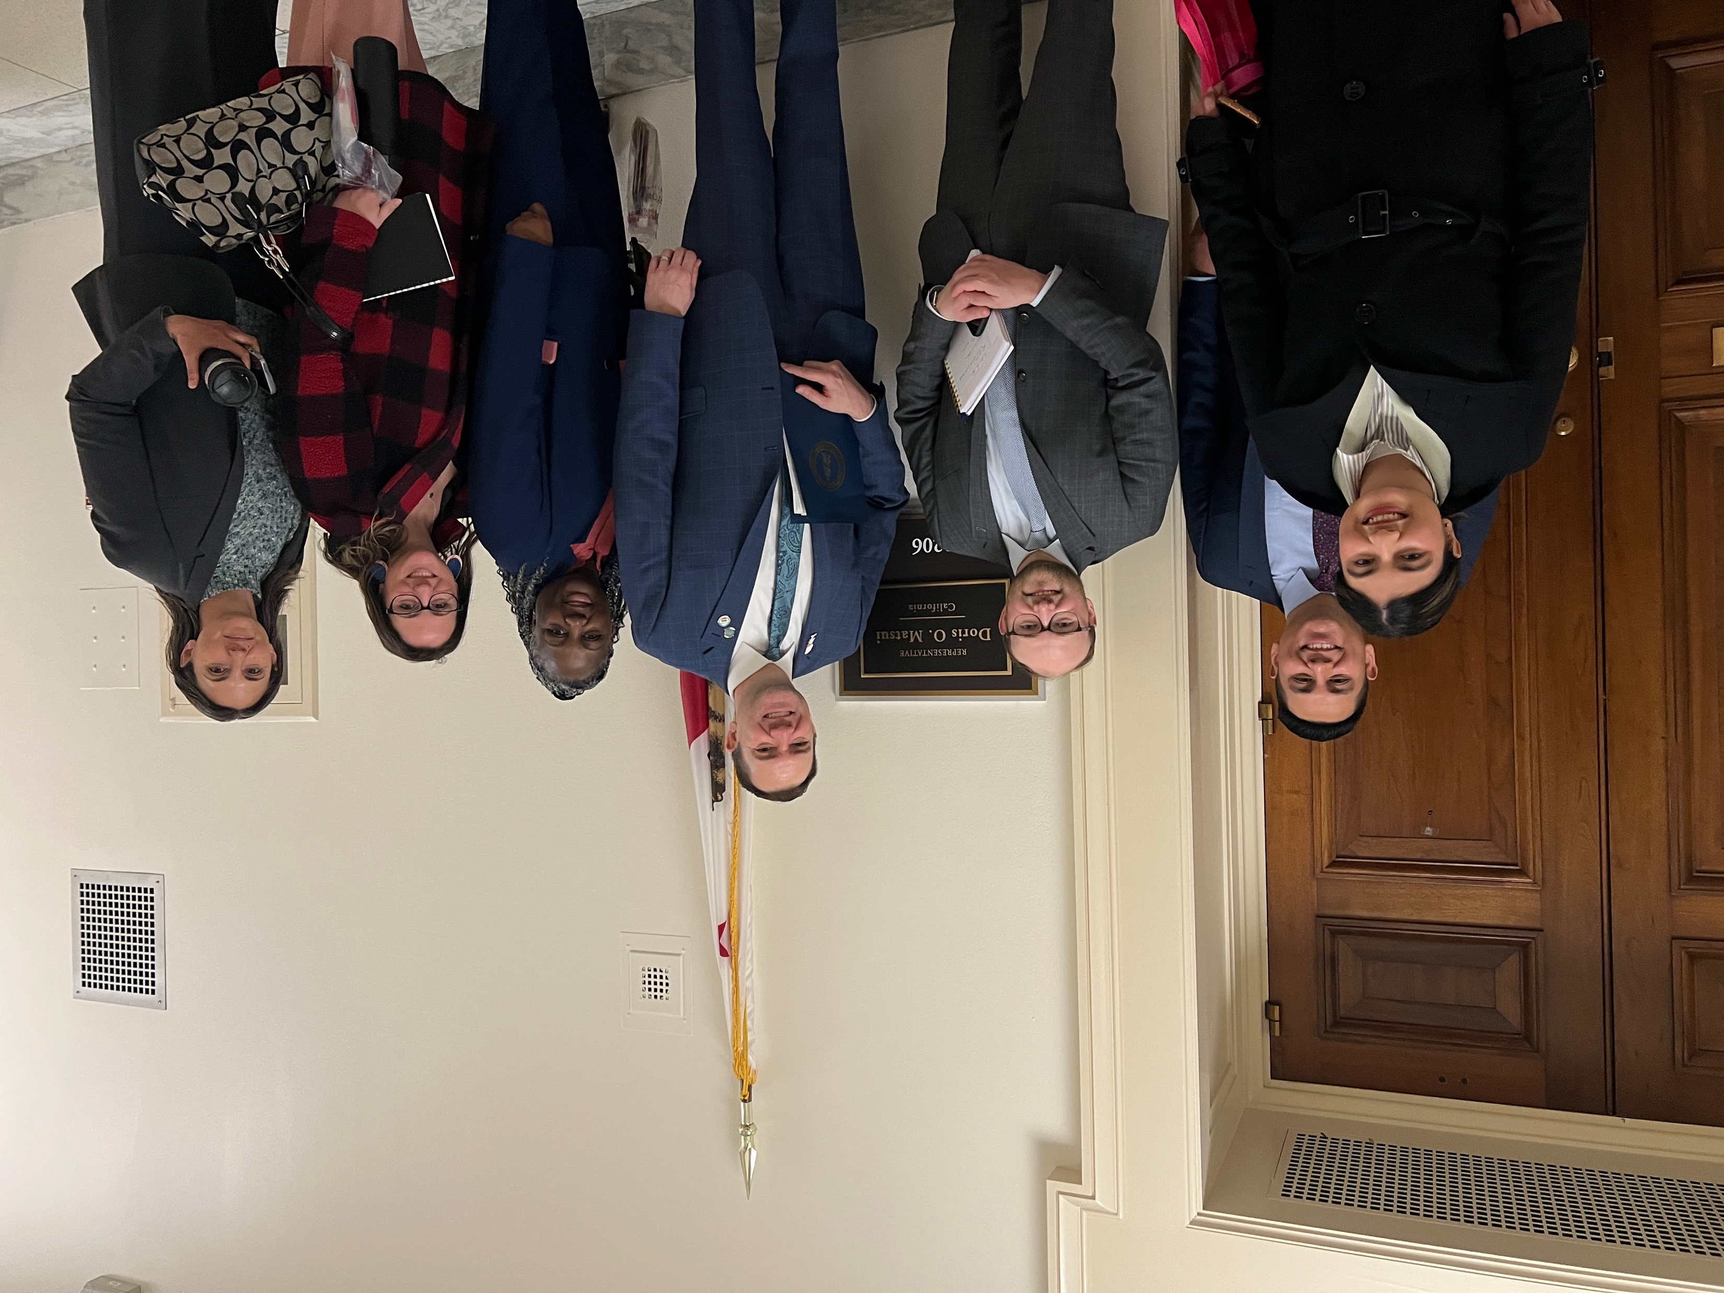
Legislative Power

Slide 16
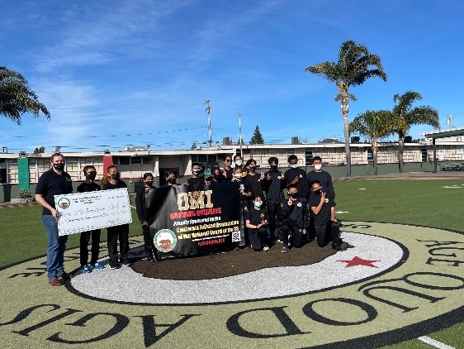
Supporting the CalGuard
Donated to Oakland Military Institute’s Track & Field Program
Provided gas cards to CMD Family
Programs – distributed to Soldiers
and Airmen in need
Provided cash scholarships to
members and dependents
Financially supported private organizations within the state (i.e: First Sergeant’s Councils, Sergeants Major Association, Rising 6 Council, etc.)
$80K in support for Unit Morale Events
Notes:
SLIDE 13: CAL-EANGUS donated to the Oakland Military Institute, one of the academies in the CalGuard’s ChalleNGe program. The funds will be utilized to help the team travel to track meets throughout the state. The meets also coincide with College visits; this provides a unique opportunity for the students to visit a college they would otherwise not be able to visit.
With the high cost of gas, the State Family Programs coordinator received a lot of requests from the field stating they could not come to drill because they would spend more in fuel than what their drill check would be and asked for support. CAL-EANGUS provided over $10K in gas cards to Family Programs to assist.
CAL-EANGUS provided over $14K in cash scholarships. Scholarships are open to members and their dependents. Membership is also open to our California State Guard partners which means that scholarships are also open to them as well!
CAL-EANGUS has fielded requests to assist with local organizations at the Wing/Brigade levels. CAL-EANGUS has supported at all levels.

Slide 17

Help for NG Soldiers and Airmen
The We Care for America Foundation, Inc. (WCFA) is the 501c(3) charitable arm of EANGUS. The WCFA National Guard Emergency Relief Fund currently provides THREE types of emergency assistance:
  Individual SARGE grants (usually $500)
  Disaster relief (for major declared emergencies)
    No-interest loans up to $2,000
  Since 2004, WCFA has provided almost $2M to NG members, which includes almost $1M in grants given to NG members impacted by the COVID 19 pandemic over the last two years. These grants and the establishment of our No-Interest Loan program were made possible by significant donations from USAA and the USAA Foundation.
  For more info on the WCFA, to apply for assistance, or donate, go to https://NGRelief.org
  NGRF CAL EANGUS Donation - $20,140
Notes:
SLIDE 9: Here’s some additional details about the Financial Assistance program that EANGUS operates, mentioned on the last slide. The We Care For America Foundation is the 501c(3) charitable arm of EANGUS which provides emergency financial assistance to National Guard members. Membership in EANGUS is not required to apply, and these funds are open to both enlisted and officers who have a valid emergency. As you can see, both Grants and No-interest loans are available. Grants are usually $500; however, if you’re an EANGUS member, you may qualify for more funds depending on the circumstances. No-interest loans can be approved for up to $2,000 with repayment of those loans in small increments over time.
The NO-INTEREST LOAN program was opened in February 2021 and was made possible by several significant donations from USAA. USAA also provided the funding which allowed We Care for America to distribute almost $1M in grants to National Guard members impacted by the COVID pandemic since May 2020. If you’ve heard of Army Emergency Relief or the Air Force Aid Society, this program is similar to those; however, as you know, AER and AFA are generally not available to Traditional Guardsmen. The EANGUS National Guard Emergency Relief Fund is available to all National Guard Soldiers and Airmen, regardless of military status or rank, and can provide assistance to currently serving, former or retired National Guard members.
Since 2004, WCFA has assisted well over 3,000 NG families; and provided almost $2M in grant funds to those in need. This is an outstanding resource for National Guard members needing help. If you hear of National Guard members who need assistance, please refer them to the website shown on this slide.
During CFC Season: WCFA is also part of the Combined Federal Campaign; we ask everyone in the National Guard to support that fund. Our CFC Number is 11859

Slide 18
Membership Benefits
Scholarships: EANGUS awards over $300,000 annually in full-ride and partial scholarships from various University partners, corporate partner sponsorships, and personal donations.
Professional Development : EANGUS provides opportunities for professional development several times each year in order to assist our members in understanding how government works and the role EANGUS plays in the legislative process. Additionally, these events give National Guard servicemembers the opportunity to hear current information from Senior Military and government leaders.
News & Publications: EANGUS membership includes a subscription to the quarterly New Patriot Magazine, the monthly Drill Weekend Talking Points, and a weekly Minuteman Update as well as other information.
Notes:
SLIDE 7: In addition to advocating for the National Guard on Capitol Hill, EANGUS provides a number of member benefits which are highlighted on the next couple of slides.
One of the largest benefits offered is the Scholarship program. Each year, over $300,000 in scholarships is awarded to current EANGUS members and their dependents. This includes FULL-RIDE scholarships to institutions such as University of Phoenix, Grand Canyon University, Grantham and Colorado Tech, as well as $1000 and $2000 cash scholarships. In addition to what EANGUS offers, most State Associations also offer a number of State-level cash scholarships that members can apply for. If you, or your spouse or child, are pursuing a college education, this is a great opportunity.
EANGUS also offers a number of Professional Development and networking opportunities throughout the year. One of them is the Professional Development program at the National Conference. This is a nationally recognized PD program and the Chief, NGB authorizes a certain number of junior enlisted National Guard members (E6 and below), per State, to attend the EANGUS Conference on paid military orders. EANGUS brings many high level guest speakers to the conference providing opportunities for attendees to speak directly with DOD, NGB, VA, and other leaders.
EANGUS also provides a number of publications to our members to keep them informed. This includes the quarterly New Patriot Magazine which is mailed to your home and/or sent electronically, the monthly Drill Weekend Talking Points message providing the latest topics to share with other unit members, and a weekly e-newsletter called the Minuteman Update.

Slide 19



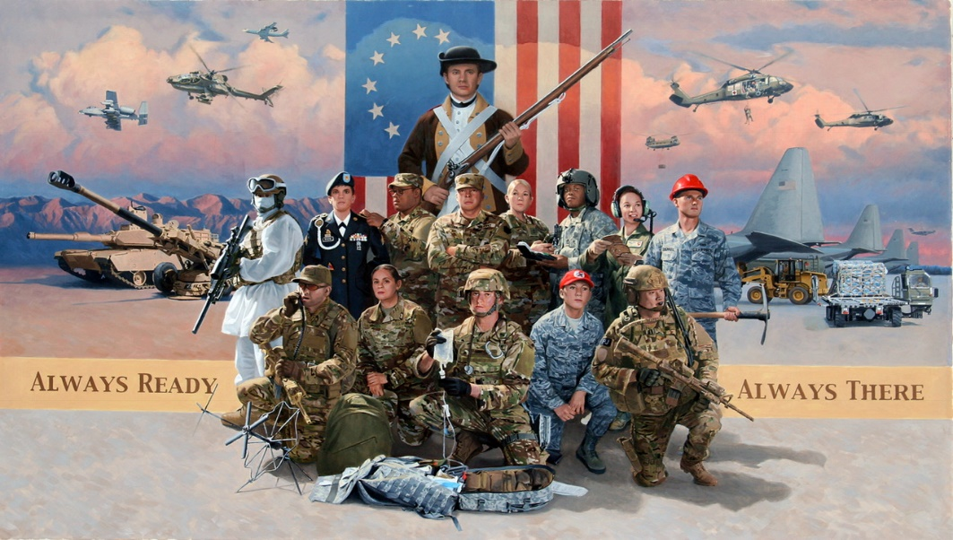




EANGUS
@EANGUS72
EANGUSNationalOffice
EANGUS
1 Massachusetts Avenue NW, Suite 880
Washington D.C. 20001-1401
800-234-EANG (3264)
Email: eangus@eangus.org
Website: www.eangus.org
Thank you for your membership!
Notes:
SLIDE 11: As I wrap up today’s briefing, are there any other questions that I can answer at this time? If not, I encourage you to write down this website – www.eangus.org and refer back to it later to get more information. I would also encourage you to find/like/follow the “Enlisted Association of the National Guard of the United States”, on social media (Facebook, Instagram, Linkedin, etc). This is the best way to stay informed, get updates on the Scholarship program and other benefits of membership, and see what EANGUS is working on. The QR code on this slide will take you right to the EANGUS website and get you started.
NOTE: Speaker can take the opportunity at this time to talk about membership, any State membership specials, talk about Annual and Life membership options, and any other activities you have going on at the State level. Also provide your State Association’s website.
We appreciate your time today… please remember that EANGUS is the only professional association that works solely to support National Guard enlisted members. Your support and membership is appreciated. Thank you.

Slide 20


Membership Drive
All members in the grade of E-1 thru E-4 are entitled to
free membership to CAL-EANGUS
caleangus.org/free
Notes:
As mentioned at the start of this presentation, the bigger the membership, the bigger the voice and the stronger the advocacy. To that end, CAL EANGUS is offering free membership for our California Guardsmen in the grade of E-1 – E-4.
SLIDE 14: CAL-EANGUS is offering all members in the grade of E-1 thru E-4 a free membership to CAL-EANGUS. Once signed up, members are entitled to use the benefits of membership (Scholarships, We Care for America Grants, life insurance and discounts provided by AUSA).

Slide 21
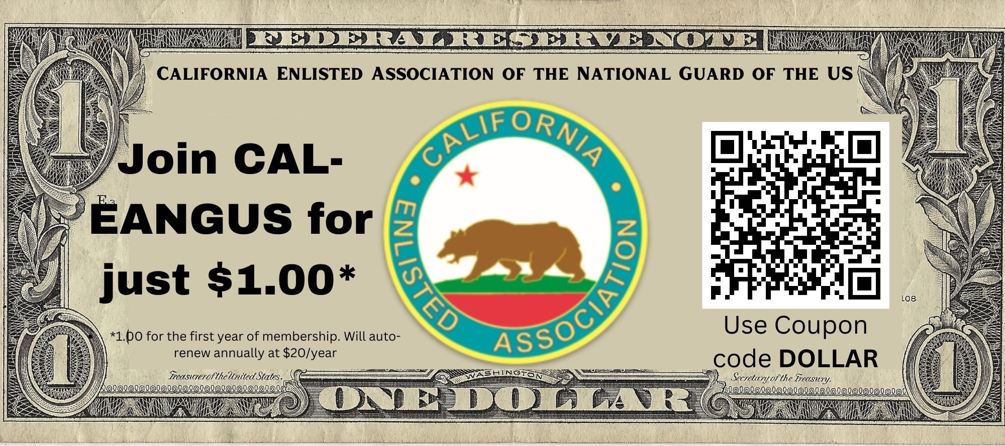
Notes:
For all others, there is another deal to become a member of CAL EANGUS. Annual dues are $20, but use this QR code and use coupon code DOLLAR and thie first year of membership will be free!

Slide 22

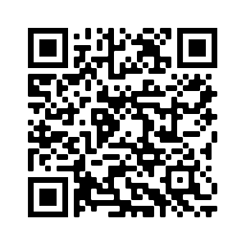
Membership Drive
$200 Life membership (normally $250)
USE CODE: LIFE50 AT CHECKOUT
Expires at the end of the the month
Notes:
SLIDE 14: Finally, if you would rather just pay one time and never have to worry about paying annual dues, CAL EANGUS offers a Life Membership Plan. For this presentation, CAL EANGUS is offering $50 off of all Life Membership plans. Simply scan the QR code and enter coupon code CSLO at checkout to receive $50 off.

Slide 23
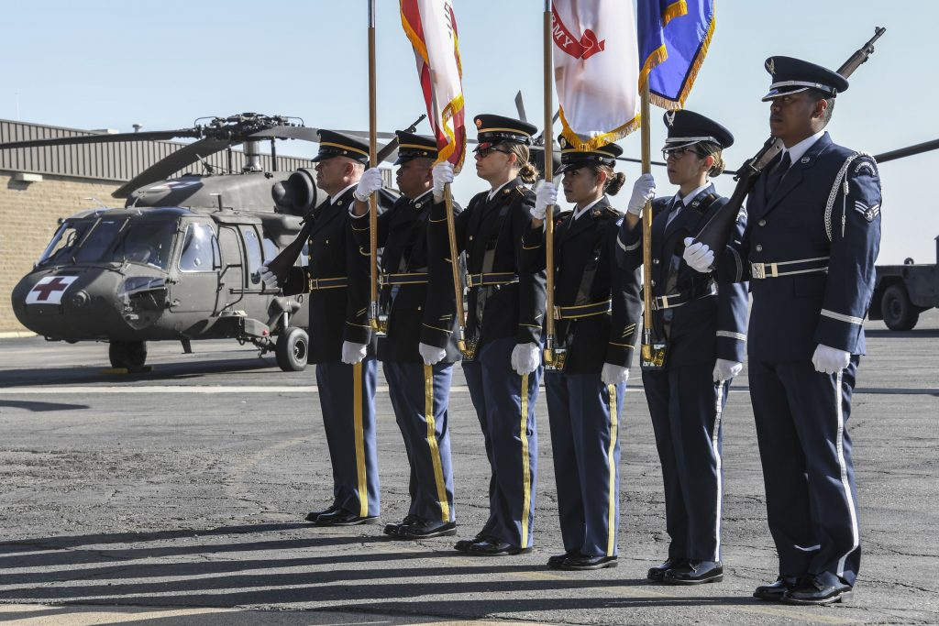
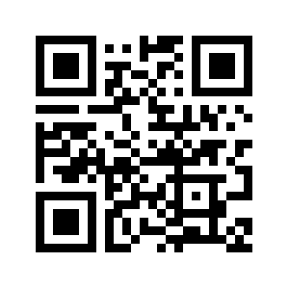

@CALEANGUS
CAL-EANGUS
PO Box 785
Folsom, CA 95763
Email: caleangus31@gmail.com
Website: www.caleangus.org
Anyone can be a member and support!
Notes:
SLIDE 11: As I wrap up today’s briefing, are there any other questions that I can answer at this time? If not, I encourage you to write down this website – www.caleangus.org and refer back to it later to get more information. I would also encourage you to find/like/follow the “California Enlisted Association of the National Guard of the United States”, on social media (Facebook, Instagram, Linkedin, etc). This is the best way to stay informed, get updates on the Scholarship program and other benefits of membership, and see what EANGUS is working on. The QR code on this slide will take you right to the CALEANGUS website and get you started.
Also for clarification, ANYONE can be a member of CAL EANGUS. There are 2 tiers of membership; Enlisted Membership or Associate Membership. Enlisted members is open for anyone who is or was ever an Enlisted member of the Armed Services. Associate members is everyone else (commissioned officers, civilians, CSG members who never served in a federal capacity, etc.)
NOTE: Speaker can take the opportunity at this time to talk about membership, any State membership specials, talk about Annual and Life membership options, and any other activities you have going on at the State level. Also provide your State Association’s website.
We appreciate your time today… please remember that EANGUS is the only professional association that works solely to support National Guard enlisted members. Your support and membership is appreciated. Thank you.

